Slide 1
第三章 立体及其交线
Chapter 3 Solids and Their Intersections
棱柱的投影Projection of Prism
棱锥的投影Projection of Pyramid
圆柱的投影Projection of Cylinder
圆锥的投影Projection of Cone
平面与平面立体相交 Intersection of Plane and Polyhedral Solid
平面与圆柱相交 Intersection of plane and Cylinder
平面与圆锥相交 Intersection of plane and Cone
平面与圆球相交 Intersection of plane and Sphere
立体相交Intersection of slides

Slide 2
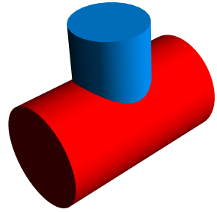

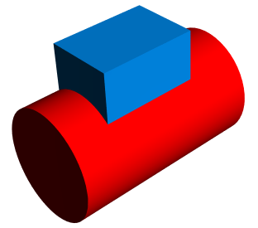
立体与立体相交 Intersection of solids
1. 概述 Introduction
两立体相交，其表面产生的交线叫做相贯线。
The intersection lines of two solids are on the surfaces of the solids
相贯的形式 Various intersection
平面体与回转体相贯
Intersection between plane solid and revolved solid
回转体与回转体相贯
Intersection between two revolved solids
复合相贯
Composite
intersection

Slide 3

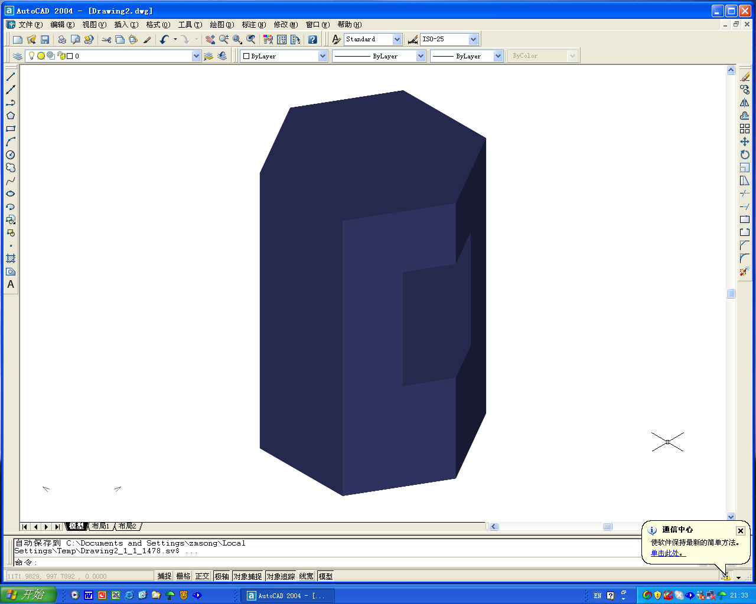
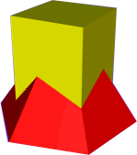
2. Intersection of plane solids
相贯型平面立体

Slide 4
Complete the side view 完成左视图
P18-1

Slide 5
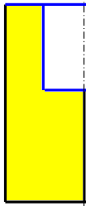

Complete the side view 完成左视图

Slide 6
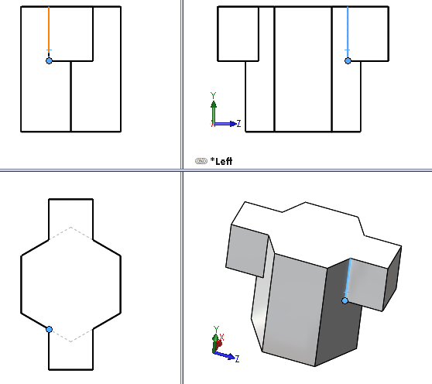
参考模型视图Refer to the modeling and 4 views

Slide 7
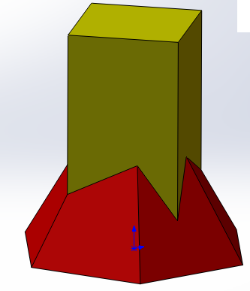
Complete the Front view 完成主视图
2'
1'
3'
相贯线的水平投影积聚在四棱柱的水平轮廓线上Intersection lines on the top view concentrated onto these lines
1
相贯线（交线）Intersection
2
3

Slide 8

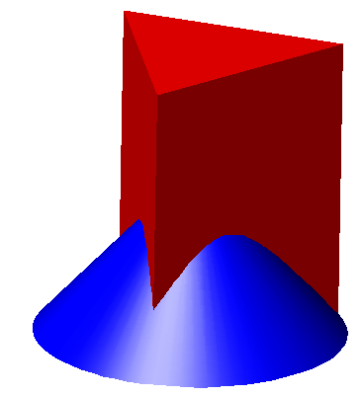
3. 平面立体和回转体相贯Intersection of plane solid and revolved solid
平面立体和回转体的交线是数段平面直线或曲线的组合The intersection lines are spatial polylines composed of several plane lines which are the intersections of planes and revolved surfaces.

Slide 9
例8：补全主视图 Complete the front view.
5’
2”,5”
2’
1”
1’,3’
4’
3”,4”
3
4
2
5
1

Slide 10
如果把三棱柱换成一个三角形的孔呢？If change the triangle-prism to a through hole?

Slide 11
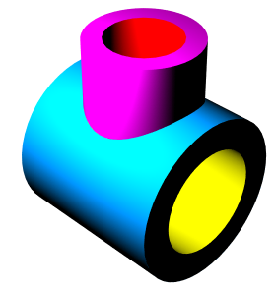
4. 回转体与回转体相贯 Intersection of two revolved solids
（1）相贯线的性质 The intersection
相贯线一般为光滑封闭的空间曲线，它是两回转体表面的共有线。The intersection usually is smooth and close spatial curve which is the common of the surfaces of two solids.
（2）作图方法Method
• 利用投影的积聚性直接找点。Finding common points by concentrative projection.
• 用辅助平面法。By auxiliary plane method
确定交线的范围
Define the limits of the intersection
（3）作图过程Steps
• 先找特殊点。Find special points fisst.
确定交线的弯曲趋势
Define the trend of the curving intersection
• 补充中间点。Add some in-between points.

Slide 12
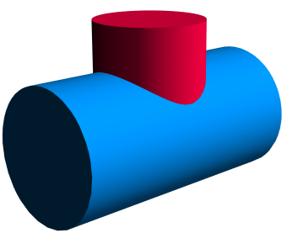
例1 ：圆柱与圆柱相贯(正交相贯)，求其相贯线。
Finding the intersection of two cylinders
1'
2'
1”,2”
●
●
●
a”
a'
●
●
●
●
●
●
3”
3'
相贯线的已知投影
find the given views of intersection
利用积聚性，采用表面取点法。By Concentrative projections
1
2
●
●
☆ 找特殊点 Special points
●
●
a
●
☆ 补充中间点Other points
3
☆ 光滑连接Connecting smoothly

Slide 13
例 1：圆柱与圆柱相贯，求其相贯线。Finding the intersection of two cylinders

Slide 14
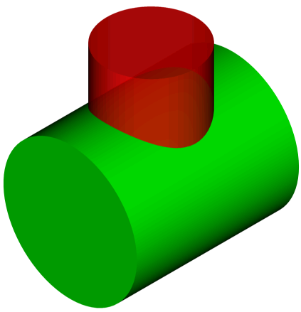
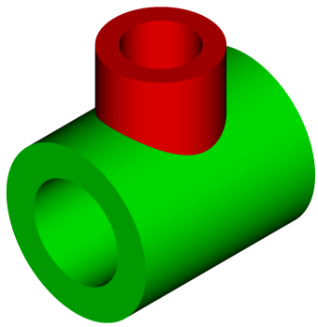
两正交圆柱相贯线的近似画法——三点法

Slide 15
两正交圆柱相贯线的近似画法——三点法

Slide 16
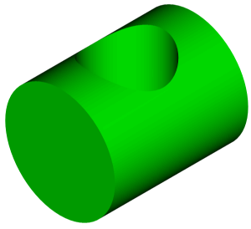
例2 求圆柱上带有孔的相贯线作图

Slide 17
例2 求圆柱上带有孔的相贯线作图

Slide 18
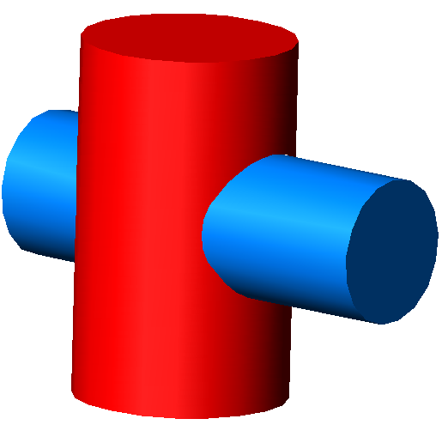
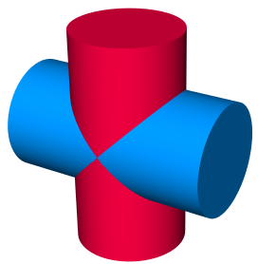
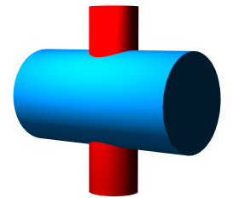
四 两回转体相贯线的变化形式 All types of intersections of two revolved solids
(1) 当圆柱直径变化时，相贯线的变化趋势
The intersection change with the radius of cylinder
交线为两条平面曲线（椭圆）
（蒙若定理）
交线为四次空间曲线交线向大圆柱轴线弯曲

Slide 19
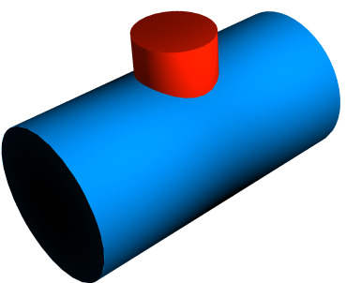
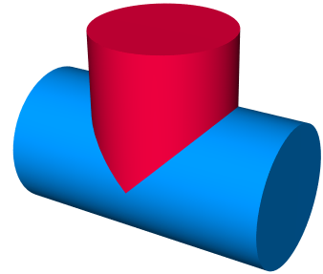
(2) 当其中一个圆柱不贯穿时：
One cylinder stops while intersects the other one

Slide 20
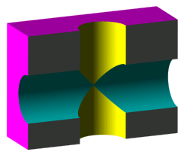
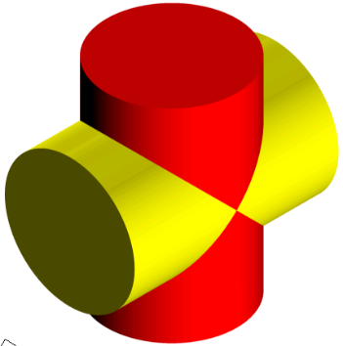
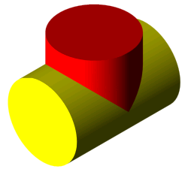


特殊相贯Special intersection

Slide 21

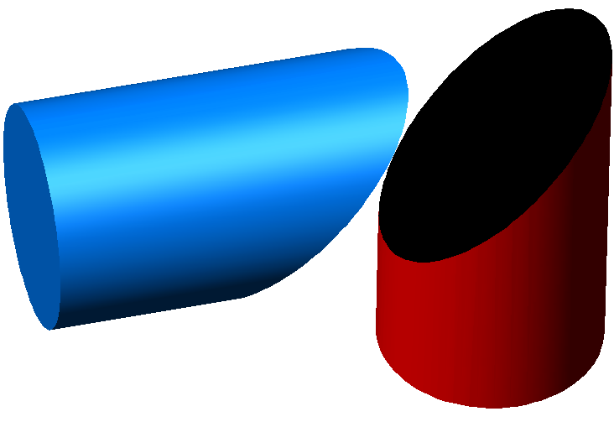

Slide 22
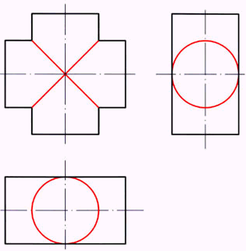
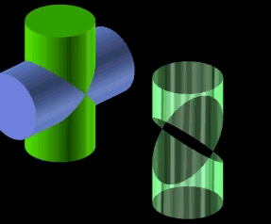
(3) Monge Theorem蒙若定理
两个二次曲面（如两个圆柱）如果与第三个二次曲面（如一个内切球）相切，则它们的交线退化成二次平面曲线（椭圆）。Two conicoids intersects at conic plane curve if both of them are tangent to a third conicoid

Slide 23
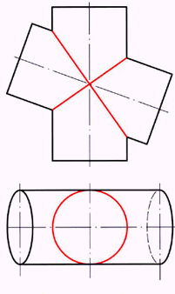
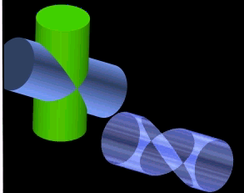
柱柱相贯（斜）
Two cylinders (not at right angle)

Slide 24
作业Homework：
P18 （1~3),
P19（1~3),
P20
参考书：P40-54

Slide 25
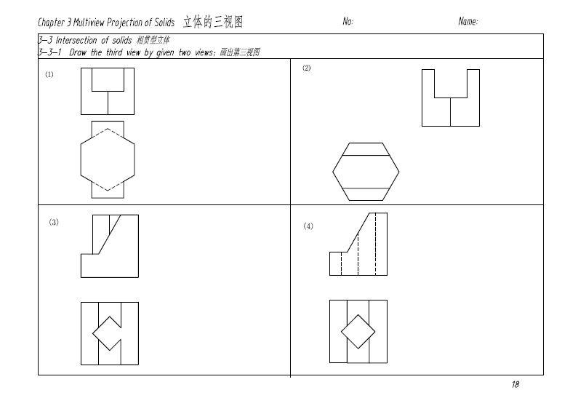
P18

Slide 26
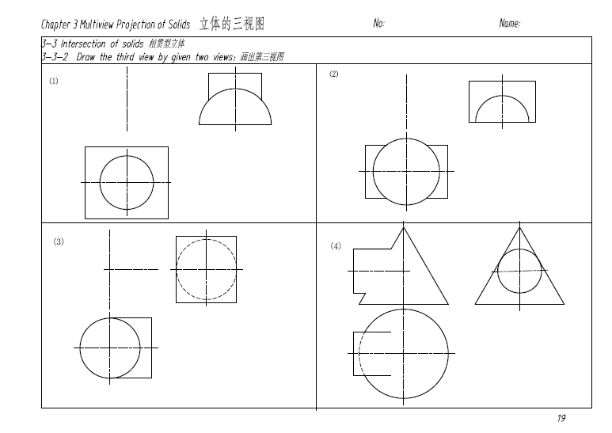
P19

Slide 27
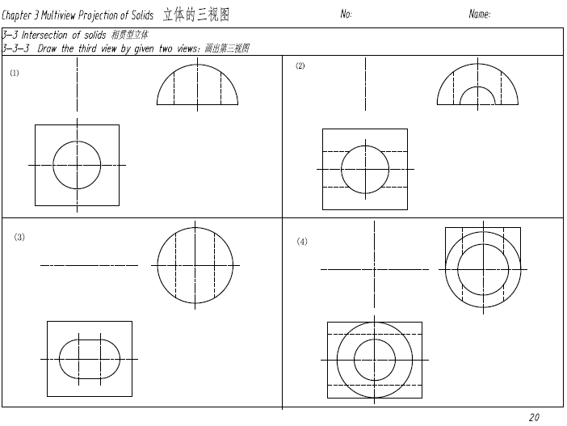
P20

Slide 28
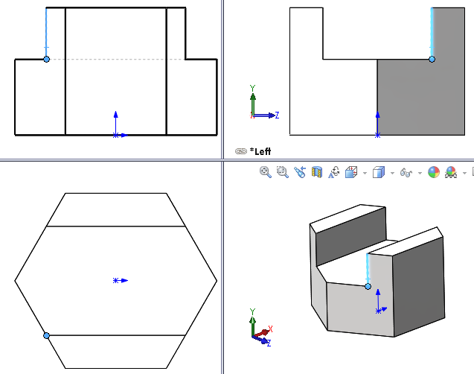
Refer to the modeling and 4 views

Slide 29




Complete the left view完成左视图

Slide 31
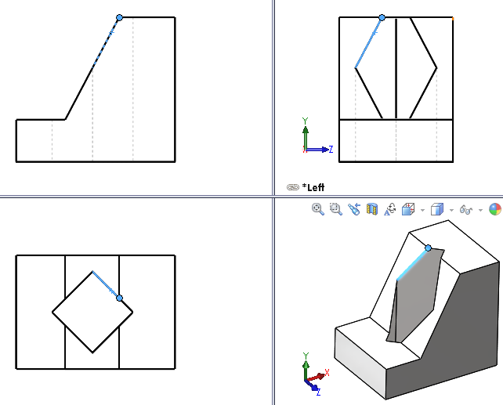
Refer to the modeling and 4 views

Slide 32

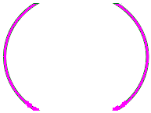
例：补全主视图 Complete the front view
●
●
●
●
●
●
●
●
●
★ 外形交线 External intersection
◆ 两外表面相贯 Two external surfaces
◆ 一内表面和一外表面相贯
One external surface and one internal surface
●
●
★ 内形交线 Internal intersection
◆ 两内表面相贯
Two internal surfaces

Slide 33
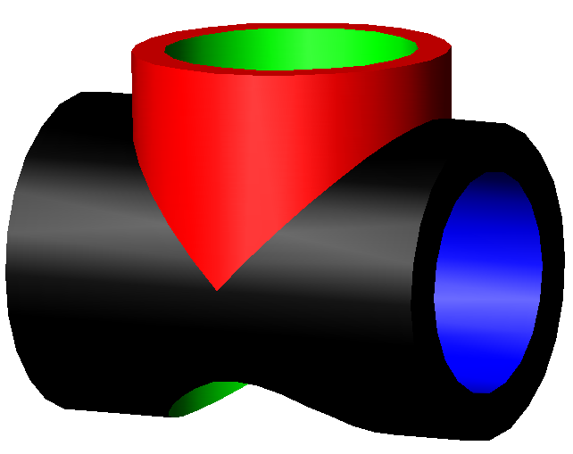
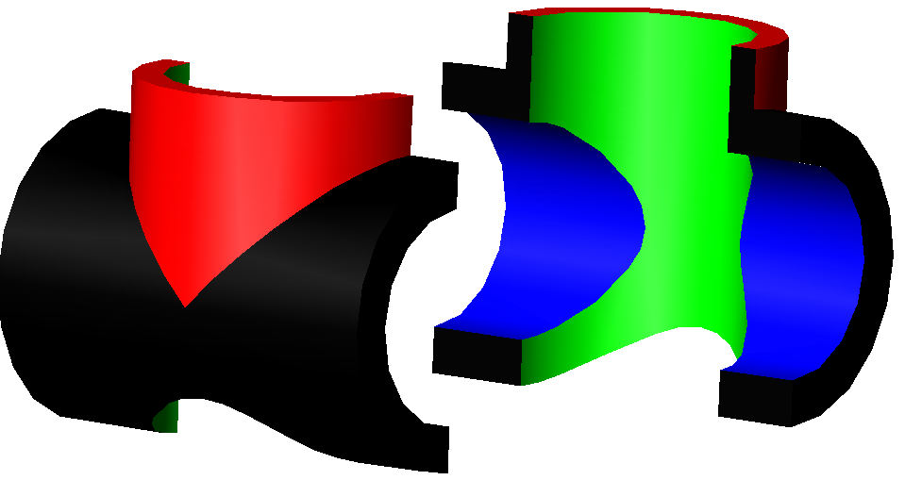
例：补全主视图 Complete the front view
无论是两外表面相贯，还是一内表面和一外表面相贯，或者两内表面相贯，求相贯线的方法和思路是一样的。
Intersections between two surfaces, no matter that they are external or internal surfaces ,can be obtained by the same method and steps.

Slide 34
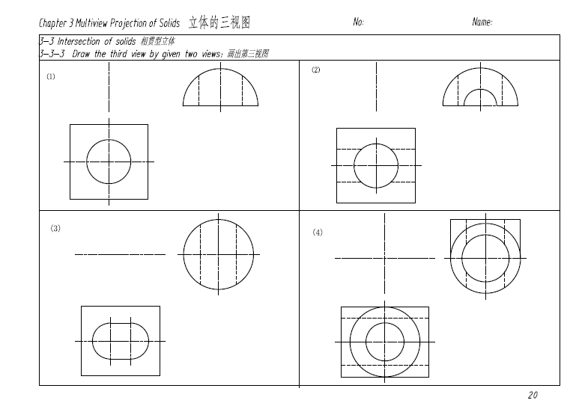
P20

